Slide 1


Exploring New Git Concepts
​Unleash the Git Magic: Journey into the Realm of Newer Concepts!

Slide 2

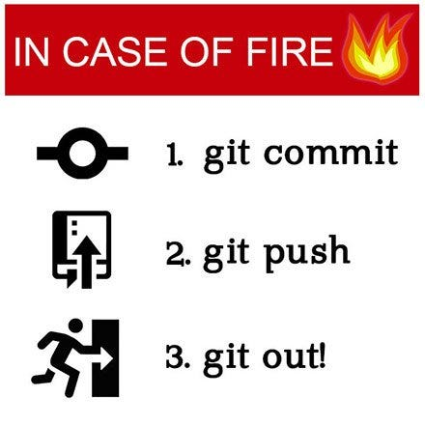
Git is a distributed version control system that tracks changes to files in a project over time. Git allows multiple developers to work on the same project simultaneously, keeping track of individual changes and merging them seamlessly.
These commands and concepts form the foundation of Git and enable developers to effectively:
manage code
collaborate with others
track changes
maintain a clean and organized version
history of their projects

Slide 3
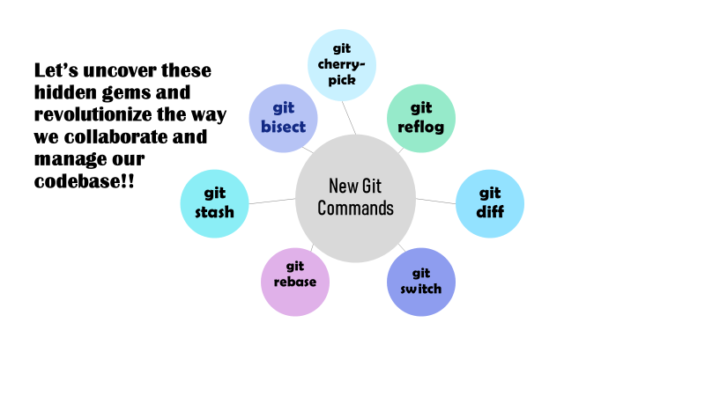
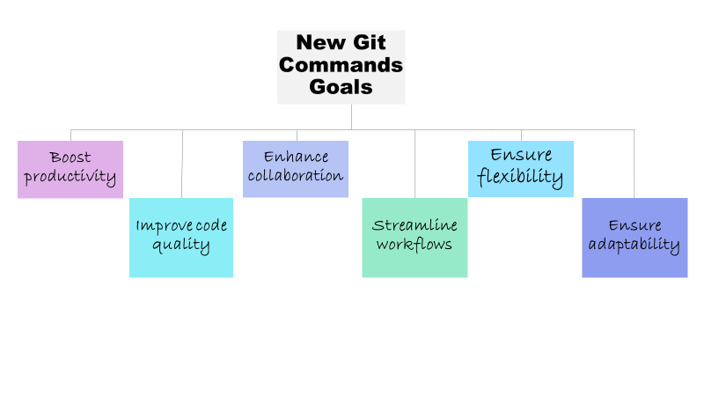

Slide 4
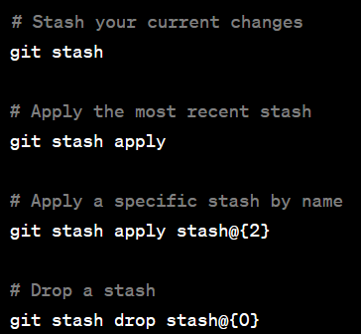
Git Stash
"git stash" temporarily saves changes in our working directory.
Stash multiple times, creating a stack of saved changes.
Switch branches without committing or losing our work.
Apply stashed changes using "git stash apply" or "git stash pop".
Resolve conflicts if they occur during stash application.
Inspect stashes with "git stash list".
Remove specific stashes using "git stash drop".
Clear the entire stash stack with "git stash clear".

Slide 5

Git Stash
Apply stashed changes using "git stash apply" or "git stash pop".
Resolve conflicts if they occur during stash application.
Inspect stashes with "git stash list".
Remove specific stashes using "git stash drop".
Clear the entire stash stack with "git stash clear".

Slide 6
Git Bisect
automates the process of binary search through the commit history, making bug hunting more efficient.
tool for identifying specific commits that introduced bugs or issues in your project.
Purpose: Pinpoint the exact commit that caused a bug or regression.
Automation: Git Bisect automates the process by performing a binary search between known good and bad commits.
Efficiency: By eliminating half of the potential commits at each step, it quickly narrows down the problematic commit.

Slide 7
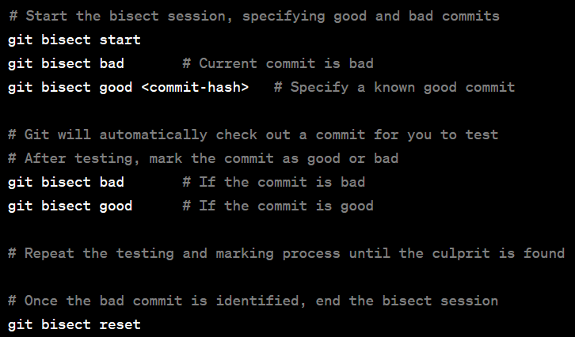
Git Bisect:
Benefits:
Time-saving: Automated search minimizes manual effort in identifying the bug's origin.
Precision: Locates the specific commit, aiding in targeted debugging and problem-solving.

Slide 8
Git Reflog
Lost Commit Recovery
Helps restore commits that may have been accidentally discarded or lost due to mistaken actions.
Troubleshooting Aid
Enables identification of problematic changes or unintended modifications to references.
Reference Tracking
Keeps a detailed history of all reference changes, including branch deletions, rebases, and resets.
Git Reflog: A reference log that records all reference changes in the repository.
Essential for recovering lost commits and troubleshooting issues.
Tracking References for Branch Recovery and Troubleshooting
allows us to "time travel" through the repository's history by providing a detailed timeline of reference changes.
Debugging Assistance by identifying which reference changes which may have caused the problem; aids in isolating and rectifying problematic modifications.

Slide 9

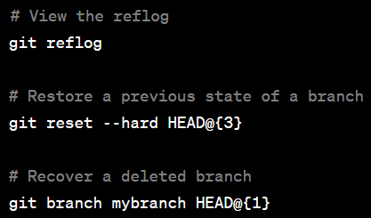
Git Reflog
Benefits:
Commit Recovery: Provides a safety net for retrieving lost or mistakenly removed commits.
Troubleshooting Support: Facilitates identifying and rectifying issues related to reference modifications.
Git Reflog acts as a valuable reference log, safeguarding your commits and assisting in troubleshooting scenarios by keeping track of all reference changes in the repository.

Slide 10

Git Diff
Purpose
Displays differences between various Git objects, such as commits, branches, or files.
File Comparison
Highlights changes line-by-line, indicating additions, deletions, and modifications.
Contextual Insights
Shows the specific lines where changes occur, aiding in understanding the nature and scope of modifications.

Slide 11
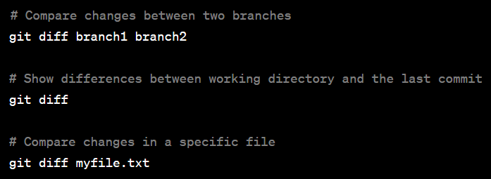
Git Diff
Features
Commit Comparison
Benefits
Code Review
Debugging Support
Working Directory Changes
Branch Comparison
Version Control
Git Diff: A command for comparing changes between different states in our Git repository.
Provides a detailed overview of modifications made to files.

Slide 12
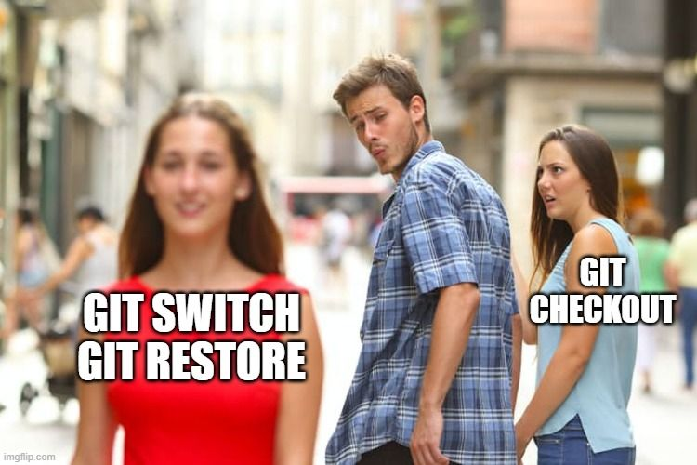
Git Switch
Purpose:
Facilitates switching from the current branch to another branch.
Intuitive Syntax:
Uses a clear and concise syntax for branch switching.
Efficient Workflow:
Enables a smooth transition between branches without unnecessary steps.
Git Switch: A command for seamless branch switching in Git.
Simplifies the process of moving between branches in your repository.

Slide 13
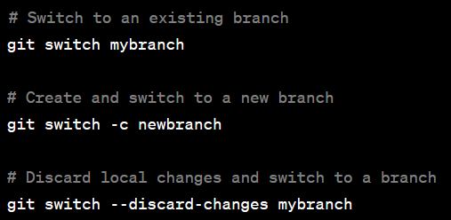
Git Switch
Basic Switch to an existing branch
Create a new branch and switch to it
Safely switch branches with uncommitted changes
Benefits:
Streamlined Branch Management
Improved Workflow Efficiency
Enhanced Collaboration

Slide 14
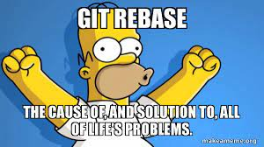
Git Rebase
Purpose:
Allows interactive and granular adjustments to commit history.
Squashing Commits:
Combine multiple commits into a single commit for a more concise history
Reordering Commits:
Rearrange commits to improve logical order or group related changes together.
Modify commit messages or content, fixing typos or addressing feedback
Editing Commits:
Git Rebase: Interactive mode provides powerful control over commit history manipulation.
Enables squashing, reordering, or editing commits for a cleaner and more organized history.

Slide 15
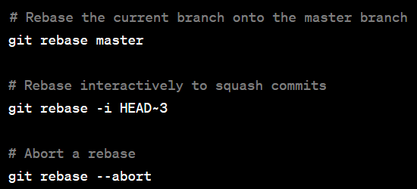
Git Rebase
Benefits:
Commit Cleanup: Enables the creation of a clean and coherent commit history, improving readability and maintainability.
Fine-grained Control: Provides flexibility in shaping commit history according to project requirements or best practices.
Collaboration Enhancement: Facilitates incorporating feedback and maintaining a clean commit history for effective collaboration.

Slide 16
Git Cherry-pick
Purpose
Selective Commit Application , Incorporating Changes
Identify Target Commit , Apply Commit
Usage Scenarios
Bug Fixes, Feature Incorporation
Process
Benefits:
Selective Integration: Incorporate specific changes, fixes, or features without merging entire branches.
Efficient Workflow: Saves time by avoiding the need to recreate changes manually or merge large branch histories.
Controlled Integration: Enables precise control over which commits are added, maintaining project stability and avoiding unintended side effects.

Slide 17

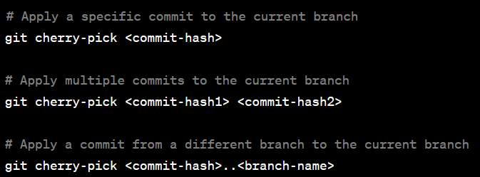
Git Cherry-pick
Git Cherry-pick: A powerful tool for applying specific commits from one branch to another.
Allows the incorporation of targeted changes or fixes into different branches.

Slide 18





Open-source licenses supported by Git and Git providers promote the freedom to use, modify, and distribute software, fostering innovation. Git and Git providers embody the philosophy of empowering developers, enabling them to control projects and contribute to the collective growth of the open-source ecosystem
Git and Git Providers: Empowering Open Source Collaboration
Git and Git providers revolutionize open-source collaboration with their core principles of transparency, accessibility, and freedom.
Decentralized version control empowers developers worldwide to contribute, review, and improve projects, fostering a vibrant open-source community.
Git's distributed nature preserves project history, enabling developers to track, share, and build upon code changes effectively.
User-friendly interfaces, documentation, and integrations offered by Git providers enhance accessibility, encouraging widespread participation.
Code reviews, issue tracking, and collaborative tools empower the community, promoting continuous improvement and knowledge sharing.

Slide 19
Thank you!!!

